Slide 1
UNIT–III
PROGRAMMING CONCEPTS

Slide 2
UNIT 1II
Using Assembly Language with C/C++ for 16-Bit DOS Applications and 32-Bit Applications-Modular programming-Using the Keyboard and Video Display-Data Conversions–Example Programs: Binary to ASCII- ASCII to Binary

Slide 3
Chapter 7: Using Assembly Language With C/C++

Slide 4
7–1 USING ASSEMBLY LANGUAGE WITH C++ FOR 16-BIT DOS APPLICATIONS
Use software to build 16-bit applications when attempting any programs in this section.
  if you build a 32-bit application and attempt the DOS INT 21H function, the program will crash
To build a 16-bit DOS application, you will need the legacy 16-bit compiler
Programs are generated using Notepad or DOS Edit.

Slide 5
Basic Rules and Simple Programs
Before assembly language code can be placed in a C/C++ program, some rules
must be learned.
Example 7–1 shows how to place assembly code inside an assembly language block within a short C/C++ program.
Assembly code in this example is placed in the _asm block.
Labels are used as illustrated by the label big.

Slide 6
EXAMPLE 7–1
//Accepts and displays one character of 1 through 9,
//all others are ignored.
void main(void)
{
_asm
{
mov ah,8 ;read key no echo
int 21h
cmp al,‘0’ ;filter key code
jb big
cmp al,‘9’
ja big
mov dl,al ;echo 0 – 9
mov ah,2
int 21h
big:
}
}
15CS101L PROGRAMMING LAB

Slide 7

15CS101L PROGRAMMING LAB

Slide 8
Extremely important to use lowercase characters for any inline assembly code.
  if you use uppercase, you will find some
  assembly language commands and registers
  are reserved or defined words in C/C++
Example 7–1 reads one character from the console keyboard, and then filters it through assembly language so that only the numbers 0 through 9 are sent back to the video display.
It shows how to set up and use some simple programming constructs in C/C++.

Slide 9
Note that AX, BX, CX, DX, and ES registers are never used by Microsoft C/C++.
  these might be considered scratchpad registers, available to use with assembly language
If you wish to use any of the other registers, make sure that you save them with a PUSH before they are used and restore them with a POP afterwards.
  if you fail to save registers used by a program,
  the program may not function correctly and can crash the computer

Slide 10
What Cannot Be Used from MASM Inside an _asm Block
MASM contains features, such as conditional commands (.IF, .WHILE, .REPEAT, etc.)
The inline assembler does not include the conditional commands from MASM.
  nor does it include the MACRO feature found
  in the assembler
Data allocation with the inline assembler is handled by C.

Slide 11
Using Character Strings
Example 7–3 illustrates a simple program that uses a character string defined with C and displays it so that each word is listed on a separate line.
  notice the blend of both C statements and assembly language statements
The WHILE statement repeats the assembly language commands until the null (00H) is discovered at the end of the character string.

Slide 12
For each space, the program displays a carriage return/line feed combination.
This causes each word in the string to be displayed on a separate line.

Slide 13
EXAMPLE 7–3
// Example that displays showing one word per line
void main(void)
{
char strings[] = “This is my first test application using _asm. \n”;
int sc = -1;
while (strings[sc++] != 0)
{
_asm
{
push si
mov si,sc ;get pointer
mov dl,strings[si] ;get character
cmp dl,‘ ’ ;if not space
jne next
mov ah,2 ;display new line
mov dl,10
int 21h
mov dl,13
next: mov ah,2 ;display character
int 21h
pop si
}
}
}
15CS101L PROGRAMMING LAB

Slide 14
Using Data Structures
Example 7–5 uses a data structure to store names, ages, and salaries.
It then displays each of the entries by using a few assembly language procedures.
The string procedure displays a character string, no carriage return/line feed combination is displayed—instead, a space is displayed.
The Crlf procedure displays a carriage return/line feed combination.
  the Numb procedure displays the integer

Slide 15
// Program illustrating an assembly language procedure that
// displays the contents of a C data structure.
// A simple data structure
typedef struct records
{
char first_name[16];
char last_name[16];
int age;
int salary;
} RECORD;
// Fill some records
RECORD record[4] =
{ {“Bill” ,”Boyd” , 56, 23000},
{“Page”, “Turner”, 32, 34000},
{“Bull”, “Dozer”, 39. 22000},
{“Hy”, “Society”, 48, 62000}
};
// Program
void main(void)
{
int pnt = -1;
while (pnt++ < 3)
{
Str(record[pnt].last_name);
Str(record[pnt].first_name);
Numb(record[pnt].age);
Numb(record[pnt].salary);
Crlf();
}
}
15CS101L PROGRAMMING LAB

Slide 16
Str (char *string_adr[])
{
_asm
{
mov bx,string_adr
mov ah,2
top:
mov dl,[bx]
inc bx
cmp al,0
je bot
int 21h
jmp top
bot:
mov al,20h
int 21h
}
}
Crlf()
{
_asm
{
mov ah,2
mov dl,13
int 21h
mov dl,10
int 21h
}
}

Slide 17
L2:
pop dx
cmp dl,bl
je L3
mov ah,2
add dl,30h
int 21h
jmp L2
L3:
mov dl,20h
int 21h
}
}
Numb (int temp)
{
_asm
{
mov ax,temp
mov bx,10
push bx
L1:
mov dx,0
div bx
push dx
cmp ax,0
jne L1

Slide 18
An Example of a Mixed-Language Program
Example 7–6 shows how the program can do some operations in assembly language and some in C language.
The assembly language portions of the program are the Dispn procedure that displays an integer and the Readnum procedure, which reads an integer.
The program makes no attempt to detect or correct errors.

Slide 19
EXAMPLE 7–6
/*
A program that functions as a simple calculator to perform addition,
subtraction, multiplication, and division. The format is X <oper> Y =.
*/
int temp;
void main(void)
{
int temp1, oper;
while (1)
{
oper = Readnum(); //get first number and operation
temp1 = temp;
if ( Readnum() == ‘=’ ) //get second number
{
15CS101L PROGRAMMING LAB

Slide 20
switch (oper)
{
case ‘+’:
temp += temp1;
break;
case ‘-’:
temp = temp1 – temp;
break;
case ‘/’:
temp = temp1 / temp;
break;
case ‘*’:
temp *= temp1;
break;
}
Dispn(temp); //display result
}
else
Break;
}
}
}
15CS101L PROGRAMMING LAB

Slide 21
int Readnum()
{
int a;
temp = 0;
_asm
{
Readnum1:
mov ah,1
int 21h
cmp al,30h
jb Readnum2
cmp al,39h
ja Readnum2
sub al,30h
shl temp,1
mov bx,temp
shl temp,2
add temp,bx
add byte ptr temp,al
adc byte ptr temp+1,0
jmp Readnum1
Readnum2:
Mov ah,0
mov a,ax
}
return a;
}
Dispn (int DispnTemp)
{
_asm
{
mov ax,DispnTemp
mov bx,10
push bx
Dispn1:
mov dx,0

Slide 22
ASSEMBLY LANGUAGE WITH C/C++ 231
div bx
push dx
cmp ax,0
jne Dispn1
Dispn2:
pop dx
cmp dl,bl
je Dispn3
add dl,30h
mov ah,2
int 21h
jmp Dispn2
Dispn3:
mov dl,13
int 21h
mov dl,10
int 21h
}
}

Slide 23
7–2 USING ASSEMBLY LANGUAGE WITH VISUAL C/C++ FOR 32-BIT APPLICATIONS
32-bit applications are written with Microsoft Visual C/C++ Express for Windows and16-bit applications using Microsoft C++ for DOS.
Visual C/C++ Express for Windows is more common today.
Visual C/C++ Express cannot easily call DOS functions such as INT 2lH.

Slide 24
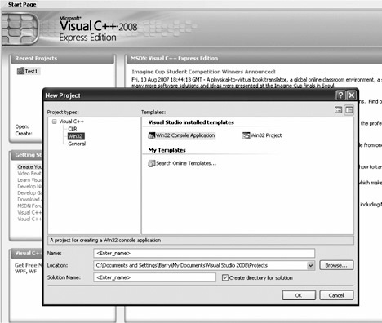
Figure 7–1 The new project screen selection of a WIN32 console application.

Slide 25
Directly Addressing I/O Ports
If a program is written that must access an actual port number, we can use console I/O commands such as the _inp(port) command to input byte data, and the _outp(port,byte_data) command to output byte data.
When writing software for the personal computer, it is rare to directly address an I/O port, but when software is written for an embedded system, we often directly address an I/O port.

Slide 26
I/O ports may not be accessed in Windows environment if you are using Windows NT, Windows 2000, Windows XP, or Windows Vista.
The only way to access the I/O ports in these modern operating systems is to develop a kernel driver.
  at this point in the text it would not be practical
  to develop such a driver
In Windows 95 or 98, you can use inp and outp instructions in C/C++ to access I/O ports.

Slide 27
Developing a Visual C++ Application for Windows
The Microsoft Foundation Classes (MFC) is a collection of classes that allows us to use the Windows interface without a great deal of difficulty.
The MFC has been renamed to the common language runtime (CLR) in Visual C++ Express.

Slide 28
To create a Visual C++ form-based application, start Visual C++ Express and click on Create Project near the upper left corner of the start screen.
Figure 7–2 illustrates what is displayed when the CLR Windows Forms application type is selected under Visual C++ Express Projects.
Enter a name for the project and select an appropriate path for the project, then click on OK.

Slide 29
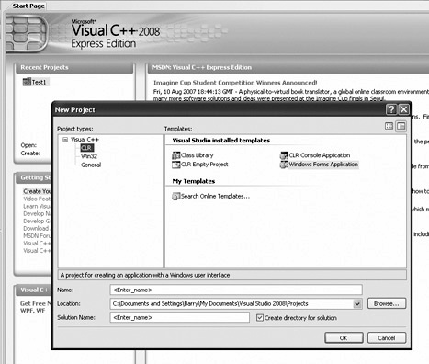
Figure 7–2 Starting a C++ program for Windows in Visual C++ Express.

Slide 30
After a few moments the design screen should appear as in Figure 7–3.
In the middle section is the form created by this application.
To test the application, as it appears, find the green arrow located somewhere above the form and below the Windows menu bar at the top of the screen and click on it to compile, link, and execute the dialog application.
You have just created and tested your very first Visual C++ Express application.

Slide 31
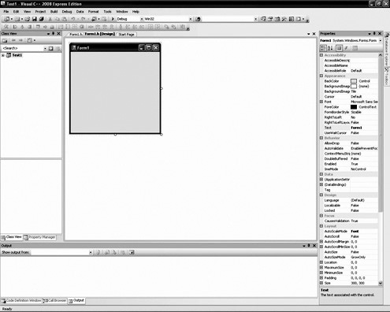
Figure 7–3 Design window screen shot.

Slide 32
In the screen shot in Figure 7–3, several items are important to program creation and development.
  the right margin contains a Properties window, with the properties of the form; the left margin contains Solution Explorer
The tabs, at the bottom of Solution Explorer window, allow other views to be displayed such as a class view and so forth in this area.
The tabs at the bottom of the Properties window allow the classes, properties, dynamic help, or output to be displayed in this window.

Slide 33
To create a simple application, select the toolbox by clicking on Tools at the top of the screen or by opening the View dropdown menu and selecting Toolbox from the list.
Click on the button control near the top of the toolbox, which selects the button.
Now move the mouse pointer (do not drag the button) over to the dialog application in the middle of the screen and draw, by left-clicking and resizing the button near the center.
See Figure 7–4.

Slide 34
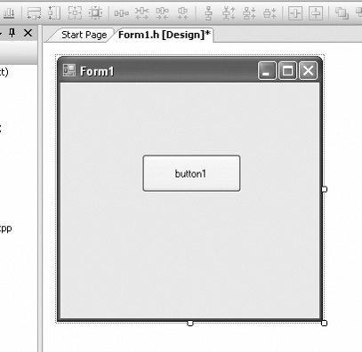
Figure 7–4 A button control placed on the form.

Slide 35
EXAMPLE 7–8
private: System::Void button1_Click(System::Object^ sender,
System::EventArgs^ e)
{
}
EXAMPLE 7–9
//Version (a)
private: System::Void button1_Click(System::Object^ sender,
System::EventArgs^ e)
{
button1->Text = “Wow, Hello”;
}
//Version (b)
private: System::Void button1_Click(System::Object^ sender,
System::EventArgs^ e)
{
String^ str1 = “Wow, Hello World”;
button1->Text = str1;
}

Slide 36
Once the button is placed on the screen, an event handler must be added so pressing or clicking the button can be handled.
The event handlers are selected by going to the Properties window and clicking on the yellow lightning bolt.
Make sure that the item selected for events is the button1 object.
To switch back to the Properties window from the event window, click on the icon just to the left of the lightning bolt.

Slide 37
Locate the Click event (should be the first event) and then double-click on the textbox to the right to install the event handler for Click.
The view will now switch to the code view and change the location of the button click software.
The software currently in view is the button1_Click function, which is called when the user clicks on the button.
This procedure is illustrated in Example 7–8.

Slide 38
We can modify the application to a more complex application as shown in Figure 7–5.
The caption on the button has been changed to the word “Convert.”
To return to the design screen, select the tab at the top of the program window that is labeled Form1.h[design]*.
When in the Design window, change the caption on button1 by clicking the button and finding the Text property from the properties of button1 in the Properties window.

Slide 39
Change the Text property to “Convert.”
In Figure 7–5 there are three Label and
three textbox controls in the illustration
below and to the left of the Convert button.
These controls are located in the toolbox.
Draw them on the screen in approximately the same place as in Figure 7–5.
The labels are changed in properties for each label control.
Change the text for each label as indicated.

Slide 40
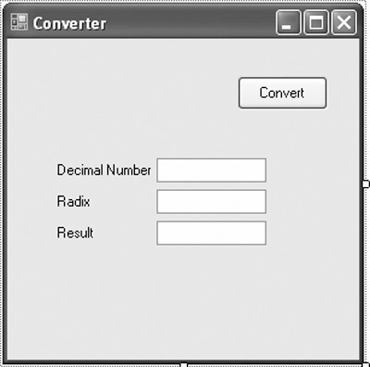
Figure 7–5 The first application.

Slide 41
EXAMPLE 7–10
private: System::Void button1_Click(System::Object^ sender,
System::EventArgs^ e)
{
int number = Convert::ToInt32(textBox1->Text);
}

Slide 42
EXAMPLE 7–11
private: System::Void button1_Click(System::Object^ sender,
System::EventArgs^ e)
{
try
{
int number = Convert::ToInt32(textBox1->Text);
}
catch (...) // catch any error
{
MessageBox::Show(“The input must be an integer!”);
}
}
15CS101L PROGRAMMING LAB

Slide 43
private: System::Void button1_Click(System::Object^ sender,
System::EventArgs^ e)
{
String^ result = “”;
int number;
int radix;
try
{
number = Convert::ToInt32(textBox1->Text);
radix = Convert::ToInt32(textBox2->Text);
}
catch (...) // catch all Convert errors
{
MessageBox::Show(“All inputs must be integers!”);
}
15CS101L PROGRAMMING LAB

Slide 44
if (radix < 2 || radix > 36)
{
MessageBox::Show(“The radix must range between 2 and 36”);
}
else
{
do // conversion algorithm
{
char digit = number % radix;
number /= radix;
if (digit > 9) // for letters
{
digit += 7; // add bias
}
digit += 0x30; // convert to ASCII
result = digit + result;
}
while (number != 0);
}
textBox3->Text = result;
}
15CS101L PROGRAMMING LAB

Slide 45
The goal is to display any number entered in the Decimal Number box as a number with any radix (number base) as selected by the number entered in the Radix box.
The result appears in the Result box when the Convert button is clicked.
To switch to the program view, click on the Form1.h tab at the top of the Design window.
To obtain the value from an edit control, use Text property to obtain a string version of the number.

Slide 46
The string must be converted to an integer.
The Convert class provided in C++ performs conversion from/to most data types.
  the Convert class member function ToInt32 is used to transform the string into an integer
The difficult portion of this example is the conversion from base 10 to any number base.
  will only function correctly if the number entered into textbox1 is an integer
If a letter or anything else is entered, the program will crash and display an error.

Slide 47
Windows does not use ASCII code, it uses Unicode so the Char (16-bit Unicode) is needed in place of the 8-bit char.
A 0x30 is added to each digit to convert to ASCII code in the example.
Horner’s algorithm:
  divide the number by the desired radix
  save the remainder and replace the number
  with the quotient
  repeat steps 1 and 2 until the quotient is zero

Slide 48
Since this is an assembly language text, the Convert class is not going to be used.
  the function is quite large
To see how large, you can put a breakpoint in the software to the left of a Convert function by clicking on the gray bar to the left of the line of code.
  a brown circle, a breakpoint, will appear
If you run the program, it will break (stop) at this point and enter the debugging mode so it can be viewed in assembly language form.

Slide 49
To display the disassembled code, run the program until it breaks, and then go to the Debug menu and select Windows. In the Windows menu, near the bottom, find “Disassembly.”
The registers can also be displayed to step through a program in assembly language.

Slide 50
The main problem with using inline assembly code is that the code cannot be placed into a Windows-managed forms application in a managed class.
In order to use the assembler, the function must be placed before the managed class in order for it to compile.
Therefore, in the project properties, Common Runtime Support must also be changed to /clr from the default setting of /clr:pure so it will compile successfully.

Slide 51
Refer to Figure 7–6 for a screen shot of how to change Common Language Runtime support to /clr.
A managed program runs under the virtual machine called .net and an unmanaged application operated in the native mode of the computer.
The inline assembler generates native code for the microprocessor so it must be unmanaged and reside before the managed class in a program.

Slide 52
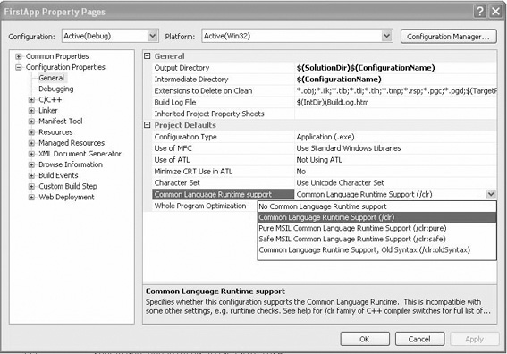
Figure 7–6 Changing to /clr for assembly language.

Slide 53
Example 7–13 illustrates how to replace part of the Horner’s algorithm with assembly code in a function called Adjust.
The adjust function tests the number for 9, and if it’s greater than 9, it adds 0x07 and then 0x30 to convert it to ASCII, which is returned.
By placing the assembly code before the managed class, it is available to the entire application and it executes in unmanaged or native mode.

Slide 54
#pragma once
namespace FirstApp {
using namespace System;
using namespace System::ComponentModel;
using namespace System::Collections;
using namespace System::Windows::Forms;
using namespace System::Data;
using namespace System::Drawing;
// short is for a 16-bit variable.
short Adjust(short n)
{
_asm
{
mov ax,n
cmp ax,9
jle later
add ax,7
later:
add ax,30h
mov n,ax
}
return n;
}
/* as an alternative version
15CS101L PROGRAMMING LAB

Slide 55
short Adjust(short n)
{
_asm
{
mov ax,n
add ax,30h
cmp ax,39h
jle later
add ax,7
later:
}
}
*/
// managed
15CS101L PROGRAMMING LAB

Slide 56
Modular programming
Many programs are too large to be developed by one person.
This means that programs are routinely developed by teams of programmers.
The linker program is provided with Visual Studio so that programming modules can be linked together into a complete program.
This section of the text describes the linker, the linking task, library files, EXTRN, and PUBLIC as they apply to program modules and modular programming.
15CS101L PROGRAMMING LAB

Slide 57
The Assembler and Linker
The assembler program converts a symbolic source module (file) into a hexadecimal object file.
It is even a part of Visual Studio, located in the C:\Program Files\Microsoft Visual Studio .NET 2003\Vc7\bin folder.
We have seen many examples of symbolic source files, written in assembly language, in prior chapters.
Example 8–1 shows how the assembler dialog that appears as a source module named NEW.ASM is assembled. Note that this dialog is used with version 6.15 at the DOS command line.
15CS101L PROGRAMMING LAB

Slide 58
EXAMPLE 8–1
C:\masm611\BIN>ml new.asm Microsoft (R) Macro Assembler Version 6.11 Copyright (C) Microsoft Corp 1981–1993. All rights reserved. Assembling: new.asm
Microsoft (R) Segmented Executable Linker Version 5.60.220 Sep 9 1994 Copyright (C) Microsoft Corp 1984–1993. All rights reserved.
Object Modules [.obj]: new.obj
Run File [new.exe]: “new.exe”
List File [nul.map]: NUL Libraries [.lib]:
Definitions File [nul.def]:
15CS101L PROGRAMMING LAB

Slide 59
the linker program, which executes as the second part of ML, reads the object files that are created by the assembler program and links them together into a single execution file.
An execution file is created with the file name extension EXE. Execution files are selected by typing the file name at the DOS prompt (C:\).
15CS101L PROGRAMMING LAB

Slide 60
If a file is short enough (less than 64K bytes long), it can be converted from an execution file to a command file (.COM). The command file is slightly different from an execution file in PROGRAMMING THE MICROPROCESSOR 251 252 CHAPTER 8 that the program must be originated at location 0100H before it can execute.
15CS101L PROGRAMMING LAB

Slide 61
C:\masm611\BIN>ml new.asm what.asm donut.asm
Microsoft (R) Macro Assembler Version 6.11 Copyright (C) Microsoft Corp 1981–1993. All rights reserved.
Assembling: new.asm
Assembling: what.asm
Assembling: donut.asm
Microsoft (R) Segmented Executable Linker Version 5.60.220 Sep 9 1994 Copyright (C) Microsoft Corp 1984–1993. All rights reserved.
Object Modules [.obj]: new.obj+
Object Modules [.obj]: “what.obj”
+ Object Modules [.obj]: “donut.obj”
/t Run File [new.com]: “new.com”
List File [nul.map]:
NUL Libraries [.lib]:
Definitions File [nul.def]:
15CS101L PROGRAMMING LAB

Slide 62
PUBLIC and EXTRN
The PUBLIC and EXTRN directives are very important to modular programming because they allow communications between modules.
We use PUBLIC to declare that labels of code, data, or entire segments are available to other program modules.
EXTRN (external) declares that labels are external to a module.
Without these statements, modules could not be linked together to create a program by using modular programming techniques.
15CS101L PROGRAMMING LAB

Slide 63
EXAMPLE 8–4
.model flat, c .data
public Data1 ;
//declare Data1 and Data2 public
public Data2
Data1 db 100 dup(?)
15CS101L PROGRAMMING LAB

Slide 64
extern
he EXTRN statement appears in both data and code segments to define labels as external to the segment. If data are defined as external, their sizes must be defined as BYTE, WORD, or DWORD. If a jump or call address is external, it must be defined as NEAR or FAR
15CS101L PROGRAMMING LAB

Slide 65
.model flat, c .
data extrn Data1:byte
extrn Data2:byte
extrn Data3:word
extrn Data4:dword
.code
extrn Read:far
15CS101L PROGRAMMING LAB

Slide 66
Libraries
Library files are collections of procedures that are used by many different programs.
These procedures are assembled and compiled into a library file by the LIB program that accompanies the MASM assembler program.
Libraries allow common procedures to be collected into one place so they can be used by many different applications.
15CS101L PROGRAMMING LAB

Slide 67
Creating a Library File. A library file is created with the LIB command, which executes the LIB.EXE program that is supplied with Visual Studio.
A library file is a collection of assembled .OBJ files that contains procedures or tasks written in assembly language or any other language.
Example 8–6 shows two separate functions (UpperCase and LowerCase) included in a module that is written for Windows, which will be used to structure a library file
15CS101L PROGRAMMING LAB

Slide 68
.586
.model flat,c
.code
public UpperCase
public LowerCase
UpperCase proc ,\
Data1:byte
mov al,Data1
.if al >= 'a' && al <= 'z'
sub al,20h
.endif
Ret
UpperCase endp
15CS101L PROGRAMMING LAB

Slide 69
LowerCase proc ,\
Data2:byte
mov al,Data2
.if al >= 'A' && al <= 'Z‘
add al,20h
.endif
ret
LowerCase endp
End
15CS101L PROGRAMMING LAB

Slide 70
Macros
A macro is a group of instructions that perform one task, just as a procedure performs one task.
The difference is that a procedure is accessed via a CALL instruction, whereas a macro, and all the instructions defined in the macro, is inserted in the program at the point of usage.
Creating a macro is very similar to creating a new opcode, which is actually a sequence of instructions, in this case, that can be used in the program.
Macro sequences execute faster than procedures because there is no CALL or RET instruction to execute.
The instructions of the macro are placed in your program by the assembler at the point where they are invoked. Be aware that macros will not function using the inline assembler; they only function in external assembly language modules.
15CS101L PROGRAMMING LAB

Slide 71
The MACRO and ENDM directives delineate a macro sequence.
The first statement of a macro is the MACRO instruction, which contains the name of the macro and any parameters associated with it. An example is MOVE MACRO A,B, which defines the macro name as MOVE.
This new pseudo opcode uses two parameters: A and B.
The last statement of a macro ENDM instruction, which is placed on a line by itself. Never place a label in front of the ENDM statement. If a label appears before ENDM, the macro will not assemble.
15CS101L PROGRAMMING LAB

Slide 72
Example 8–10 shows how a macro is created and used in a program. The first six lines of code define the macro.
This macro moves the word-sized contents of memory location B into word-sized memory location A. After the macro is defined in the example, it is used twice.
The macro is expanded by the assembler in this example, so that you can see how it assembles to generate the moves. Any hexadecimal machine language statement followed by a number (1, in this example) is a macro expansion statement. The expansion statements are not typed in the source program; they are generated by the assembler (if .LISTALL is included in the program) to show that the assembler has inserted them into the program
15CS101L PROGRAMMING LAB

Slide 73
EXAMPLE 8–10
MOVE MACRO A,B
PUSH AX
MOV AX,B
MOV A,AX
POP AX
ENDM
MOVE VAR1,VAR2 ;;move VAR2 into VAR1
PUSH AX
MOV AX,VAR2
MOV VAR1,AX
POP AX
MOVE VAR3,VAR4 ;;move VAR4 into VAR3
PUSH AX
MOV AX,VAR4
MOV VAR3,AX
POP AX
15CS101L PROGRAMMING LAB

Slide 74
Using the keyboard and display unit
Reading the Keyboard
The keyboard of the personal computer is read by many different objects available to Visual C++.
Data read from the keyboard are either in ASCII-coded or in extended ASCII-coded form.
They are then either stored in 8-bit ASCII form or in 16-bit Unicode form.
15CS101L PROGRAMMING LAB

Slide 75
Using the Video Display
As with the keyboard, in Visual C++ objects are used to display information. The textbox control can be used to either read data or display data as can most objects. Modify the application presented in Figure 8–1 so it contains an additional textbox control as shown in Figure 8–2. Notice that a few label controls have been added to the form to identify the contents of the textbox controls.
In this new application the keyboard data is still read into textbox control textBox1, but when the Enter key is typed, a decimal version of the data entered into textBox1 appears in textBox2—the second textbox control. Make sure that the second control is named textBox2 tocompatibility with the software presented.
15CS101L PROGRAMMING LAB

Slide 76
Data conversions
One main task of the system is to convert data from one form to another.
This section of the chapter describes conversions between binary and ASCII data. Binary data are removed from a register or memory and converted to ASCII for the video display.
In many cases, ASCII data are converted to binary as they are typed on the keyboard. We also explain converting between ASCII and hexadecimal data.
15CS101L PROGRAMMING LAB

Slide 77
Converting from Binary to ASCII
Conversion from binary to ASCII is accomplished in three ways:
(1) by the AAM instruction if the number is less than 100 (provided the 64-bit extensions are not used for the conversion),
(2) by a series of decimal divisions (divide by 10), or
(3) by using the C++ Convert class function ToString
15CS101L PROGRAMMING LAB

Slide 78
The AAM instruction converts the value in AX into a two-digit unpacked BCD number in AX.
If the number in AX is 0062H (98 decimal) before AAM executes, AX contains 0908H after AAM executes.
This is not ASCII code, but it is converted to ASCII code by adding 3030H to AX.
15CS101L PROGRAMMING LAB

Slide 79
void ConvertAam(char number, char* data)
{
_asm
{
mov ebx,data ;pointer to ebx
mov al,number ;get test data
mov ah,0 ;clear AH
aam ;convert to BCD
add ah,20h
cmp al,20h ;test for leading zero
je D1 ;if leading zero
add ah,10h ;convert to ASCII
D1:
mov [ebx], ah
add al,30h ;convert to ASCII
mov [ebx+1], al
}
}
private: System::Void Form1_Load(System::Objectˆ sender,
System::EventArgsˆ e)
{
char temp[2]; // place for result
ConvertAam(74, temp);
Char a = temp[0];
Char b = temp[1];
label1->Text Convert::ToString(a) + Convert::ToString(b);
}
15CS101L PROGRAMMING LAB

Slide 80
The reason that AAM converts any number between 0 and 99 to a two-digit unpacked BCD number is because it divides AX by 10. The result is left in AX so AH contains the quotient and AL the remainder.
This same scheme of dividing by 10 can be expanded to convert any whole number of any number system (if the divide-by number is changed) from binary to an ASCII-coded character string that can be displayed on the video screen.
For example, if AX is divided by 8 instead of 10, the number is displayed in octal.
15CS101L PROGRAMMING LAB

Slide 81
Horners algorithm
The algorithm (called Horner’s algorithm) for converting from binary to decimal ASCII
code is:
1. Divide by 10, then save the remainder on the stack as a significant BCD digit.
2. Repeat step 1 until the quotient is a 0.
3. Retrieve each remainder and add 30H to convert to ASCII before displaying or printing.
15CS101L PROGRAMMING LAB

Slide 82
Converting from ASCII to Binary
Conversions from ASCII to binary usually start with keyboard entry. If a single key is typed, the conversion occurs when 30H is subtracted from the number.
If more than one key is typed, conversion from ASCII to binary still requires 30H to be subtracted, but there is one additional step.
After subtracting 30H, the number is added to the result after the prior result is first multiplied by 10.
15CS101L PROGRAMMING LAB

Slide 83
The algorithm for converting from ASCII to binary is:
1. Begin with a binary result of 0.
2. Subtract 30H from the character to convert it to BCD.
3. Multiply the result by 10, and then add the new BCD digit.
4. Repeat steps 2 and 3 for each character of the number.
15CS101L PROGRAMMING LAB

Slide 84
Here, the binary number
is displayed from variable temp on label1 using the Convert class to convert it to a string.
Each time this program executes, it reads a number from the char variable array numb and converts
it to binary for display on the label.
15CS101L PROGRAMMING LAB

Slide 85
int ConvertAscii(char* data)
{
int number = 0;
_asm
{
mov ebx,data ;intialize pointer
mov ecx,0
B1:
mov cl,[ebx] ;get digit
inc ebx ;address next digit
cmp cl,0 ;if null found
je B2
sub cl,30h ;convert from ASCII to BCD
mov eax,10 ;x10
mul number
add eax,ecx ;add digit
mov number,eax ;save result
jmp B1
B2:}
return number;
}
private: System::Void Form1_Load(System::Objectˆ sender,
System::EventArgsˆ e)
{
char temp[] = “2316”; // string
int number = ConvertAscii(temp);
label1->Text = Convert::ToString(number);
}

